Slide 1


CHIPS Tuckshop App
CHIPS’ Tuck-shop Portal

Slide 2

Problem Statement
The project idea was chosen to make ordering things from the CHIPS Tuckshop easier. Being able to see what’s available and place said orders for students to just pick up and pay upon receiving. It is a simple seller to buyer application that demonstrates Vue.js’ flexibility and ability to create applications without the need of a backend. This project purely utilizes custom built API’s and Mongo DB to provide a backend.

Slide 3



Technologies and Principles
Front-end – Vue.js | Vuetify
Back-end – Express.js | Node.js
Database – MongoDB

Slide 4
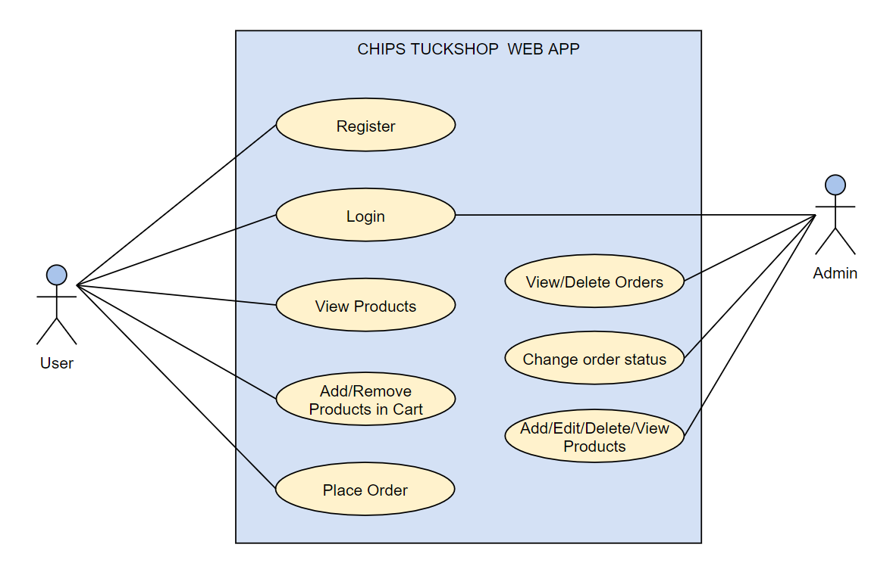
Use Case Diagram

Slide 5
Application DEMO

Slide 6
THE END!

